Slide 1
VSCode Plugin Development for Automotive App Deployment
Software Engineering Project – Team Bosch.IO
Leipzig, 28.09.2023
Maximilian Nerlich, Carlo Pötter, Martin Hoffmann & Leonardo d‘Angelico

Slide 2
PROJECT OUTLINE – SETUP, GOALS & OUTCOME
Team Bosch.IO

Slide 3




SETUP: PARTIES & INTERACTION
Software Engineering Project | Team Bosch.IO
SEP PROJECT
TEAM
Bosch.IO as Mediator between SEP Project Team (Us 4) & Eclipse Foundation
Has strategic Open Source Collaboration
We develop in Context of Eclipse Foundation Project
Role: Mentoring, Project Mediation, Tech. Guidance
Dr. Kristan: Direct Contact Person & PO; M. Grzanna = Tech. Assistance
Notes:
=> We interact with Bosch.IO

Slide 4
SETUP: PARTIES & INTERACTION
Software Engineering Project | Team Bosch.IO
SEP PROJECT
TEAM
Eclipse Foundation as Industry Open Source Incubator
Industry Standards & Hub for strategic Open Source Innovation
Embraced by Industry Leaders (like e.g. Bosch.IO)
Carries Eclipse IDE, Jakarta EE (Java Ecosystem) & 400+ Open Source Projects
Notes:
=> We interact with Bosch.IO

Slide 5
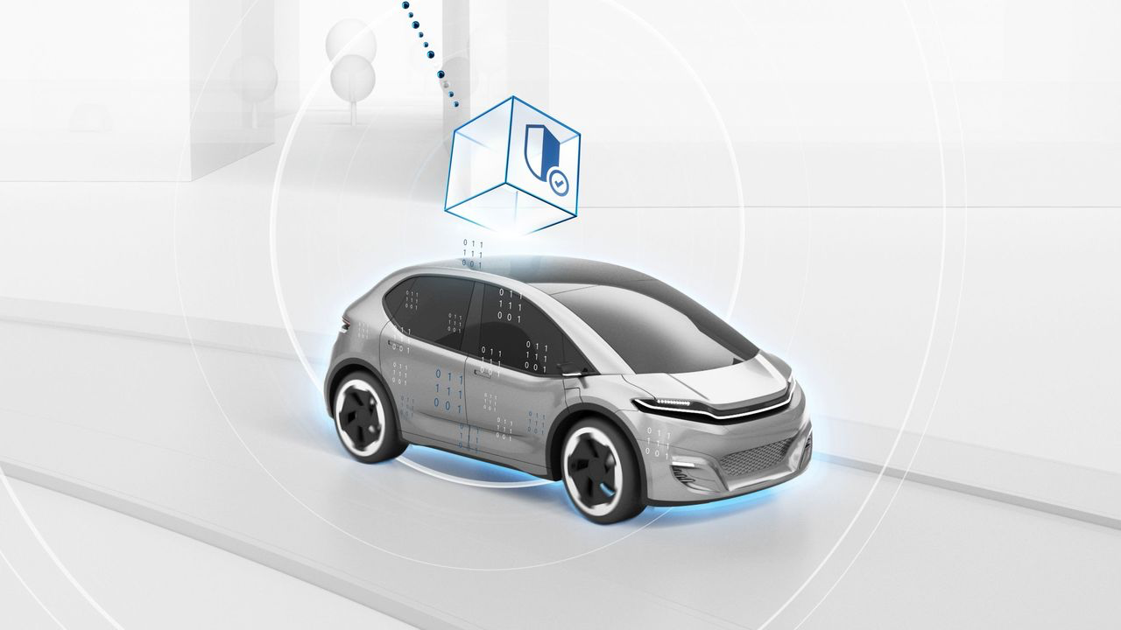
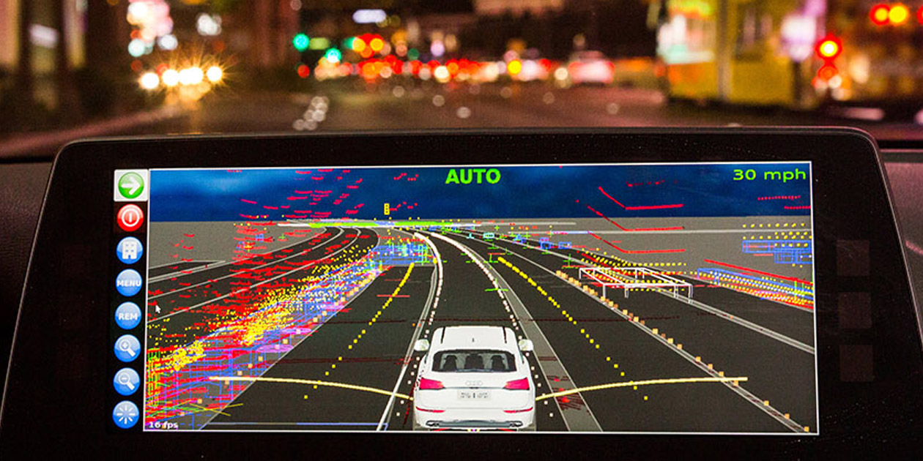


OUR PART: CONTRIBUTION TO ECLIPSE LEDA
Software Engineering Project | Team Bosch.IO
Eclipse Leda: Technology Ecosystem for Software-Defined-Vehicles (SDV)
Aims to bring various SDV-Components together in Optimization
Linux Distro (OS) with Tool Stack to deploy Apps on Vehicles
Perspective: Vehicles as „Computer“
Vehicle App
deploy
run

Slide 6
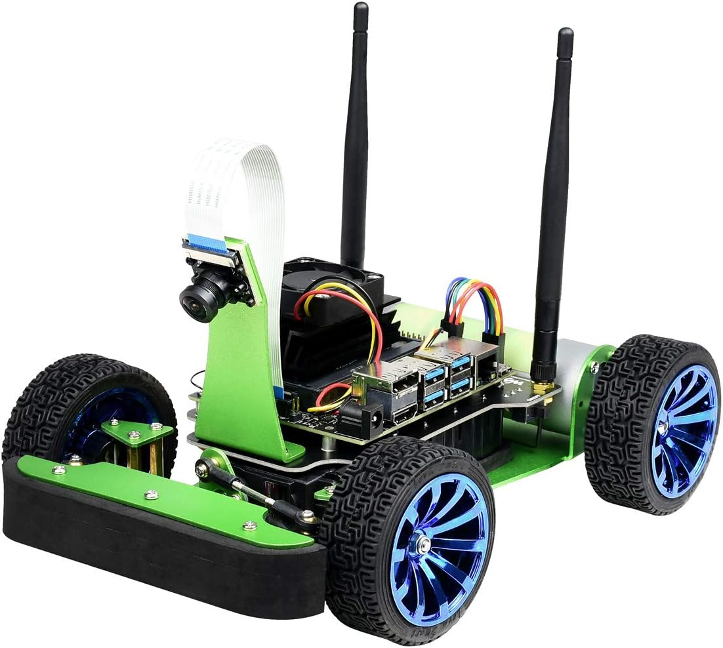



THE PROJECT GOALS
Software Engineering Project | Team Bosch.IO
A
B
C
A. Reshape inefficient „old“ Deployment Process
Melt new Deployment Process into VSCode Plugin
Test Hardware & VSCode Plugin on Jetson Nano („Racer“) that runs Leda

Slide 7
PROBLEM
Software Engineering Project | Team Bosch.IO
TWO INEFFICIENCIES IN „TRADITIONAL“ SDV DEPLOYMENT PROCESS
Manuel Configuration on Vehicle (via SSH)
Multiple Dependencies
Time Overhead
Advanced Infrastructure Knowledge needed
Internet
Error-intense
Remote Build Tools

Slide 8
SOLUTION
Software Engineering Project | Team Bosch.IO
VSCODE PLUGIN TO EASE TRIGGERING A NEW DEPLOYMENT PROCESS
Manual Configuration on Vehicle (via SSH)
Solution
Deployment in IDE via VSCode Plugin
Reshaped Process internalizing Container-Build (no Internet connection required)
Solution
Multiple Dependencies

Slide 9

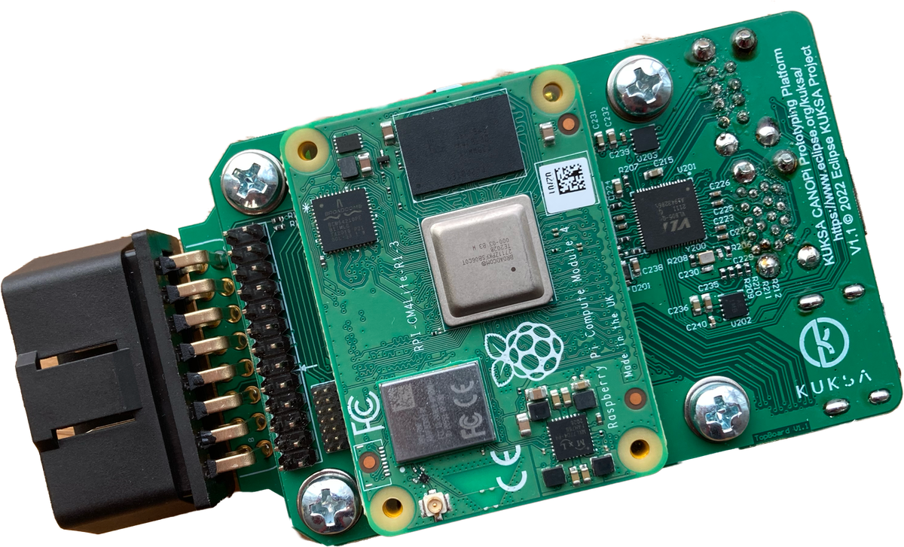




OUR DEPLOYMENT PROCESS VIA VSCODE PLUGIN
Development Flow Today
5. Download container image
MQTT
Software Engineering Project | Team Bosch.IO
2. Build image
local
Vehicle App
4. Start container
1. Develop In-Vehicle-App
3. Copy Image via local network

Slide 10
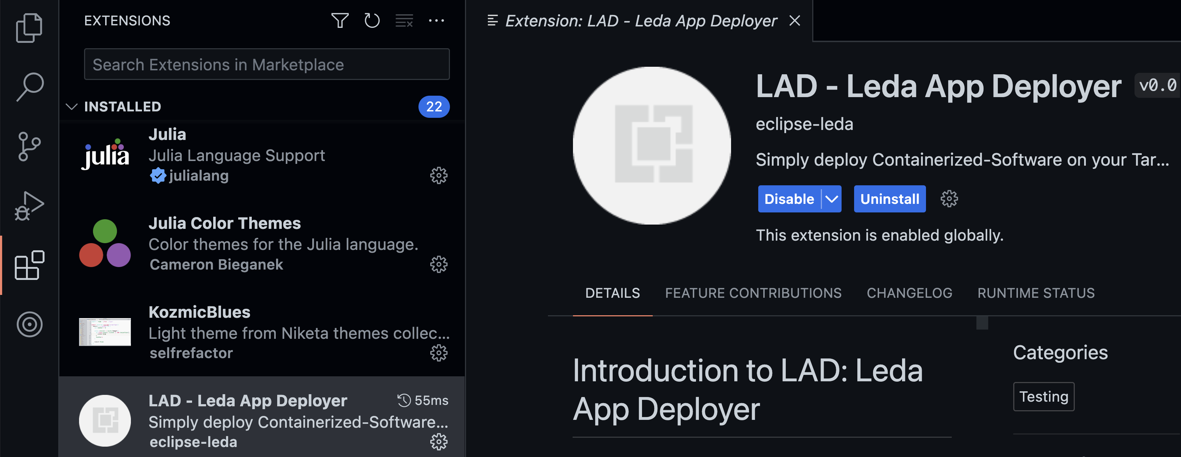



THE PLUGIN: LEDA APP DEPLOYER (LAD)
Software Engineering Project | Team Bosch.IO

Slide 11


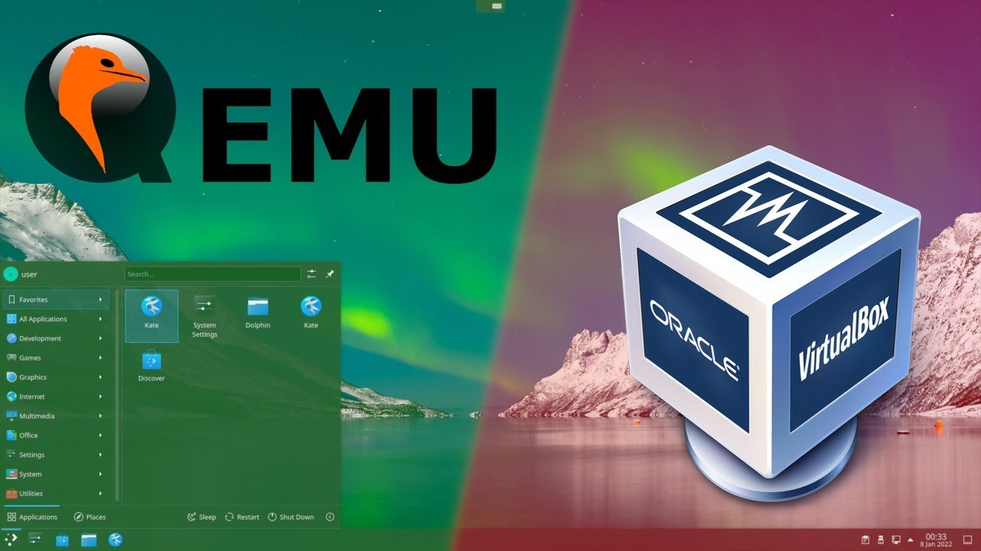

LAD IN ACTION
Software Engineering Project | Team Bosch.IO
Emulate Vehicle in Virtual Machine (QEMU)
Leda is not running on Jetson Nano
Notes:
Official Issue on GitHub -> https://github.com/eclipse-leda/leda-distro/issues/49

Slide 12

PROJECT OUTCOME & DEVIATION
Software Engineering Project | Team Bosch.IO
A
B
C
➔ Deviation: We could still run Tests with Emulation (QEMU)
Notes:
➔ Issue

Slide 13
PROJECT MANAGEMENT – ONBOARDING, FRAMEWORK & TOOLS
Team Bosch.IO

Slide 14




ONBOARDING WITH BOSCH.IO
Software Engineering Project | Team Bosch.IO
DEFINE PROJECT FRAME & SELECT PROJECT MANANGEMENT TOOLSTACK
Support from Bosch.IO:
Clarification of Project Insights (as shown)
Communication of required Skills & Technical Guidance, 5 EPICS
Contact to Project Leda Developers (Eclipse Foundation)
Definition of our Communication & Project Management Tool Stack
Define SCRUM as Framework & adapt it to our needs
Notes:
- Team Model Canvas:
- Strength, Weaknesses
- Goals, Expected Outcome
- Value we create. = WORKS GOOD FOR TEAM BUILIDING
TOOLS:
- DISCORD: Main communication channel ➔ Good: Screenshare (Pair-Programming) and Chat
- MS-Teams: Communication Bosch.IO-related ➔ Used because: it is their company communication service
- Confluence: Where we store our Documentation ➔ Used as free WIKI
- GitHub:
- ISSUES: Track our SCRUM-Related things in a Board (present later on)

Slide 15
PROJECT MANAGEMENT VIA SCRUM
Software Engineering Project | Team Bosch.IO
3 Roles
PO
Dev Team
Scrum Master
3 Artifacts
Product Backlog
Sprint Backlog
Product Increment
6 Events
Sprint
Sprint Planning
Daily Scrum
Sprint Review
Sprint Retro
Refinement
Notes:
WHY SCRUM: - Best Practice, …
clarification of project environment:
- already talked about in the beginning
Support from Bosch.io:
- contact to Eclipse
- Developer meeting with presentation of Plugin
- Project Management tool suggestions
- team model canvas to get started
- SCRUM as framework
communication of required skills
- required skills were partly communicated by max and johannes

Slide 16
SCRUM „LITE“ – OUR ADAPTION & ROLE DISTRIBUTION
Software Engineering Project | Team Bosch.IO
3 Roles
PO (Dr. Kristan)
Dev Team (all 4)
Scrum Master (M. Nerlich)
3 Artifacts
Product Backlog
Sprint Backlog
Product Increment
6 Regular Events
Sprint
Sprint Planning
Daily Scrum
Sprint Review
(Sprint Retro)
Preparation Sessions
Refinement
Sprint Backlog
Activities
Sprint 14 Days
Dev Presentations
Product Backlog
Preparation
Shippable
Increment
Refinement
Review
Notes:
Deviation:
- Roles: Dev Team is everyone (SM and the others)
- Events:
- NO Daily ➔ Time-Constraints
- Stringly Reduced Retro, we combined with Sprint Planning ➔ Not that important: Good Sentiment overall, problems tackled in Review)
- BUT Prep Sessions every week before Scrum Meetings ➔ Necessary to keep sync, for SEP-Monday-Presentation
- BUT Presentations for Leda Team (Necessary)
➔ Mentioning: Monday-Presentation-SEP, Dev-Meetings Eclipse (Irregular)
➔ Overall: We kept out basic routines
@ After the flow appeared @
- INTERACTIONS ➔ We in Team (Pair Programming, Discord, Live Coding together)
We with Johannes in Sprint Planning, Review
We with other Devs from Leda in Dev Presentation)
-

Slide 17
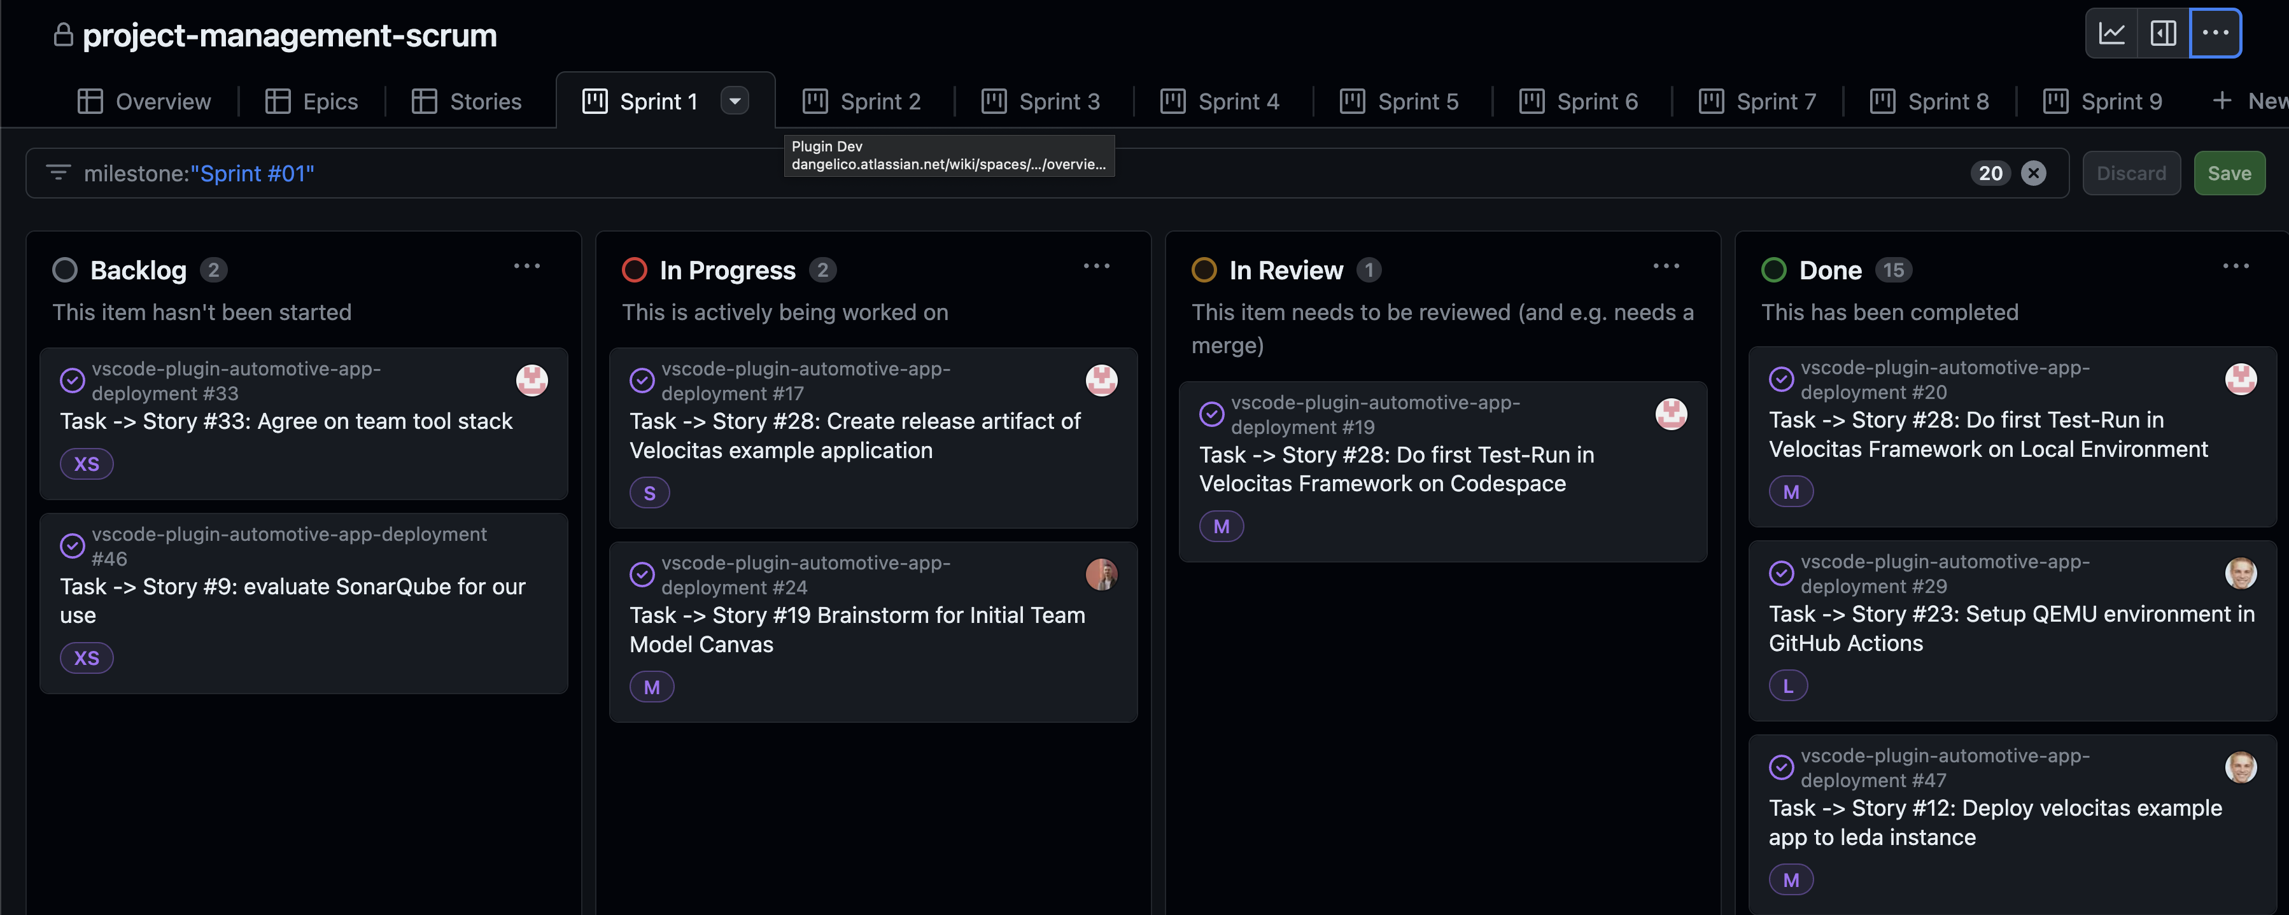
MANAGE SCRUM WITH GITHUB ISSUES BOARD
Software Engineering Project | Team Bosch.IO
Notes:
The good:
Already in our Dev-Environment
Linking Pull Requests to Tickets
We all have already accounts in GitHub
Free
The bad:
Not tailored for Scrum
E.g. No explicit Subdivision from Epics -> Stories -> Tasks,
Solution: See board (Linking via Labels (Epics) and Naming

Slide 18
DEVELOPMENT – WORKFLOW & TYPICAL ISSUES
Team Bosch.IO

Slide 19
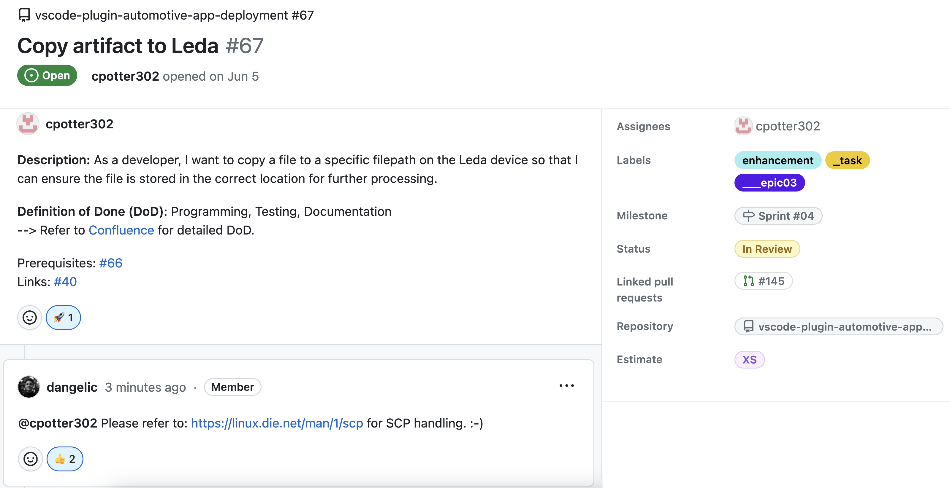
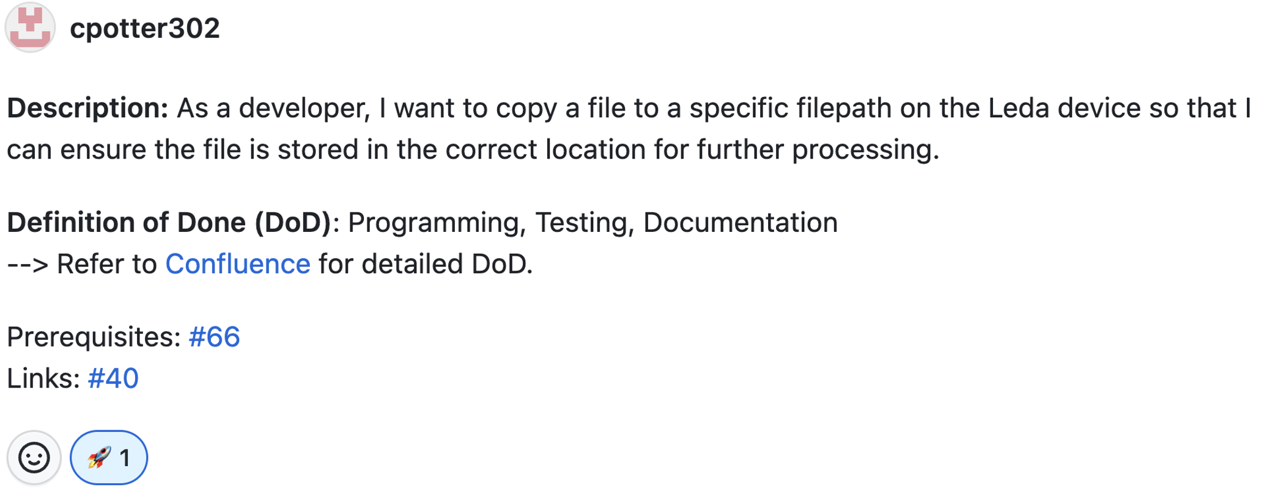
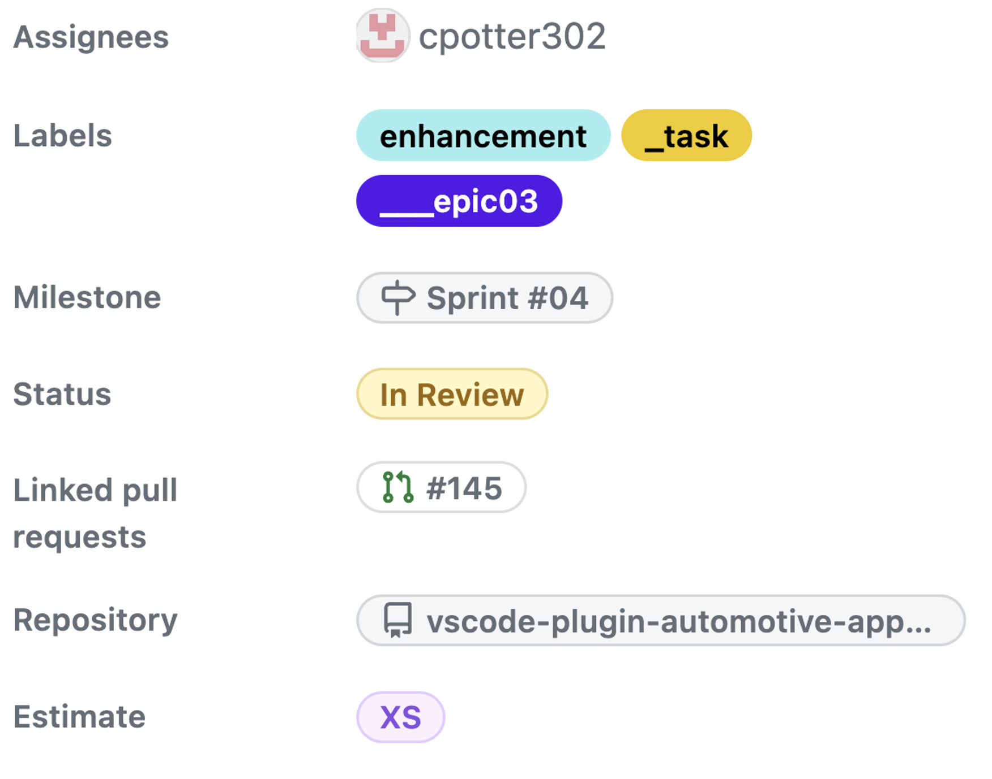
Software Engineering Project | Team Bosch.IO
Task -> Story #22 Copy Artifact to Leda #67
Code Quality
Notes:
Linked Pull request => traceabilty of issues

Slide 20


OUR IDEAL DEVELOPMENT WORKFLOW
Software Engineering Project | Team Bosch.IO
Write Ticket (BOARD)
Sight Ticket
Implement & Test Feature
Commit & push
Trigger
GitHub- Actions
Open PR
Review PR
Merge PR
Notes:
IMPLEMENTATION TOOLS
- Docker, CLI-Tools, JEST
PIPELINE: - TEST AND BUILD

Slide 21
TYPICAL ISSUES
Software Engineering Project | Team Bosch.IO
Implement & Test Feature
DEVIATION FROM OPTIMAL PROCESS
Ticket Definition & Communication Issues
Ticket is vagely defined
Estimation not precise enough
Long Review Phases (for PR)
Technical Issues
Fail of Tests or Build Pipeline
Merge Conflicts
Bad Reviews → Bugs on Master Branch
Feature is not implementable
Trigger
GitHub- Actions
Write Ticket
Review PR
Merge PR

Slide 22




DEVELOPMENT TOOL LANDSCAPE
Software Engineering Project | Team Bosch.IO
IDE / Code-Editor / Unit Testing
Crafting Architecture Diagramms
DEV-Suite for VSCode Plugin
Emulates Leda (OS)
Container Engine
Virtualization of Vehicle
Configuration Management
Command Line Tools (e.g. Docker CLI, Leda CLIs, …)
Code Version Management
Release-Pipeline & Management
Actions: Build-Test-Pipeline
Notes:
IMPLEMENTATION TOOLS
- Docker, CLI-Tools, JEST
PIPELINE: - TEST AND BUILD

Slide 23
PROJECT SUM UP – BIGGEST CHALLeNGE, HIGHLIGHT & KEY LEARNINGS
Team Bosch.IO

Slide 24


BIGGEST Challenge: BECOME PROJECT-COMPLIENT
Software Engineering Project | Team Bosch.IO
COMPLIENCE FOR THE LEDA OPEN SOURCE CONTRIBUTION
Code Compliance
… get a Repository under Project Leda
Legal Compliance

Slide 25
BIGGEST Challenge: BECOME PROJECT-COMPLIENT
Software Engineering Project | Team Bosch.IO
CODE Compliance: Source Code has to follow specific Project Standards.
Code Quality
Style Conventions
Security Standards
Maintainability
Code Quality
Style Conventions
Security Standards
Maintainability
✓ Refactor to TS Clean-Code Guidelines
✓ Use OOP-Design Principles, separate Duties
✓ Use Formatter, Linter & Pre-Commit-Hooks
✓ Emphasize Code Documentation & Readme
✓ Install Dependency Weakness Checker
✓ Seek help: Get Reviews from PO
Notes:
CODE QUALITY: Language Best Practices, KISS,
STYLE CONVENTION: Naming Conventions, Consistent Formatting
SECURITY STANDARDS: Safe Dependencies and Libraries, Security Design Patterns
MAINTAINABILITY: Important because other contributors must understand the logic

Slide 26
BIGGEST Challenge: BECOME PROJECT-COMPLIENT
Software Engineering Project | Team Bosch.IO
LEGAL Compliance: Code has to follow Open Source Licensing Guidelines.
Contribution License Agreement
Software Licensing
Dependency Licences
Legal Document Stack
Contribution License Agreement
Software Licensing
Dependency Licences
Legal Document Stack
✓ Get familiar with Apache 2.0 and MIT
✓ Sight & Implement Project Rules
✓ Replace / Remove incomplient Libraries
✓ Use related Leda Projects as Blueprint
✓ Request Dependency Scan by Eclipse
✓ Seek help: Get Assistance from PO

Slide 27
BIGGEST HIGHLIGHT: WE WILL BE PART OF LEDA
Software Engineering Project | Team Bosch.IO
… AND THE PROJECT DOES NOT END HERE FOR US
SDV as Future-proven Domain
We simplify SDV Development
But Plugin not tested on Field
Further Development required ➔ We keep Maintaining!
Code Compliance
Legal Compliance

Slide 28


KEY LEARNINGS & PROJECT SUM UP
Software Engineering Project | Team Bosch.IO
WE COULD ALL ENHANCE OUR SKILLSET IN THIS PROJECT
Technical Perspective
SDV-Development & Toolstack (Leda Environment)
Working in incubating Hightech Project
Development of VSCode Plugin
Project Management Perspective
Collaborative Toolstack on GitHub
Most important: Team & Time Management
The Open Source Perspective
Code Guidelines
Most unexpected: Various Legal Guidelines & Processes
Notes:
* INCUBATING: We learned that some crucial dependencies might not work: Workarond (e.g. Racer Emulation QEMU

Slide 29
Image sources
Eclipse Foundation: https://upload.wikimedia.org/wikipedia/commons/thumb/7/79/Eclipse_Foundation_Logo.svg/1200px-Eclipse_Foundation_Logo.svg.png
Eclipse Leda: https://projects.eclipse.org/sites/default/files/logo_02_rgb.png
VSCode: https://upload.wikimedia.org/wikipedia/commons/thumb/9/9a/Visual_Studio_Code_1.35_icon.svg/2048px-Visual_Studio_Code_1.35_icon.svg.png
Docker: https://w7.pngwing.com/pngs/991/165/png-transparent-docker-hd-logo-thumbnail.png
Discord: https://assets-global.website-files.com/6257adef93867e50d84d30e2/636e0b52aa9e99b832574a53_full_logo_blurple_RGB.png
Microsoft Teams: https://static.wixstatic.com/media/fffeb7_1fe7b9d7f11248f8a592fe28c9ea3710~mv2.png/v1/fill/w_956,h_250,al_c,lg_1,q_85,enc_auto/ms-teams-logo.png
Confluence: https://upload.wikimedia.org/wikipedia/commons/thumb/8/88/Atlassian_Confluence_2017_logo.svg/2560px-Atlassian_Confluence_2017_logo.svg.png
GitHub: https://1000logos.net/wp-content/uploads/2021/05/GitHub-logo.png
DrawIO: https://upload.wikimedia.org/wikipedia/commons/thumb/3/3e/Diagrams.net_Logo.svg/2048px-Diagrams.net_Logo.svg.png
Qemu: https://upload.wikimedia.org/wikipedia/commons/thumb/4/45/Qemu_logo.svg/2560px-Qemu_logo.svg.png

Slide 30
Team Bosch.IO THANKS FOR YOUR the attention! – Q&A
Maximilian Nerlich, Carlo Pötter, Martin Hoffmann & Leonardo d‘Angelico
M.Sc. Business Information Systems
https://github.com/software-engineering-project-org

